Slide 1
HIPAA Privacy
New Team Member Orientation

Slide 2

HIPAA Background
The Health Insurance Portability and Accountability Act (HIPAA) is federal legislation that addresses issues ranging from health insurance coverage to standard identifiers for healthcare providers – We’ve all heard it, but what does it really mean -
For our purposes, we deal with the portions of the law that speak to protecting the privacy and security of health data, which HIPAA refers to as Protected Health Information or PHI
Notes:
Congress felt that additional privacy and security protections were necessary once transmission of health claims and other health information became uniform and electronic.
Required compliance with HIPAA became effective on April 14, 2003
What is Protected Health Information (PHI)?
(includes all personal demographic & health information)

Slide 3
What is Protected Health Information - PHI?
  PHI is ANY information, transmitted or maintained in any medium (written, electronic, verbal) including demographic data that is
  Created/received by a covered entity or business associate
  Relates to/describes past, present or future physical or mental health or condition; or past, present or future payment for healthcare; and
  Can be used to identify the patient
Examples
  Written documentation/paper records
  Spoken and verbal information, including voice mail messages
  Electronic databases and any electronic information including
      Research information
      PHI stored on a computer, smart phone, memory card, USB drive, etc.
  Photographic images
  Audio and Video recordings

Slide 4
Elements of Protected Health Information
Names
Demographic subdivisions smaller than the state (Street address, city, county, zip code)
Dates of Birth, death, admission, treatment, discharge
Phone numbers and Fax numbers
E-mail address, IP Address, URLs
Social Security Number
Medical record number, account number, health plan beneficiary numbers
Full face photographic images and any comparable images
Certificate/license numbers
Vehicle identifiers (VIN) and serial numbers including license plates
Device identifiers and serial numbers
Biometric identifiers, including finger and voice prints
Any other unique identifying numbers, characteristic, or code

Slide 5

Patient Rights under HIPAA
Patients are provided a Notice of Privacy Practice
Patients may request:
An accounting of disclosures of PHI
An amendment to their medical record
Confidential and/or Alternative communications of PHI
Further Restrictions of PHI
Amendment of PHI
File a complaint regarding a potential privacy concern
If you are presented with any of these situations, please contact the
ECU Health Privacy office at (252) 847-6545 or ecuh_privacy@ecuhealth.org for assistance!
Notes:
Patients may Request an Accounting of Disclosures of their ECU maintained PHI which has been made during the past six years
Patients are permitted to request a listing showing to whom their PHI has been disclosed
Does not include disclosures made for treatment, payment, or health care operations; disclosures made pursuant to patient’s own authorization or disclosures prior to April 14, 2003 (effective date of rule)
Does not include disclosures made for national security or intelligence purposes, or law enforcement purposes
Patients have the right to request the method whereby they will be contacted (e.g., what telephone number, location, etc.)
Any requests to communicate PHI by alternate means must be submitted in writing using the ECU Request for Alternate Communication Form
Patients may request that their PHI not be disclosed in a certain manner, even if it is permitted under HIPAA
Common requests include no disclosure for fundraising purposes (institutions are otherwise permitted to use minimal PHI for fundraising purposes), no disclosure to certain government agencies, or certain family members
Requests must be made in writing using ECU’s Request for Restriction on the Use and Disclosure of PHI Form
ECU may accept or decline request
Patients may request a correction to the medical record
Provider is not required to amend; however, must notify patient regarding decision
Typically happens with sensitive types of conditions: Obesity, mental illness conditions, etc.

Slide 6
How can PHI be used?
An authorization from the patient is NOT required when PHI is used for
  Treatment (T)
  Payment (P)
  Healthcare Operations (O), such as quality improvement, credentialing, compliance, patient safety
  You may hear this referred to as TPO
Notes:
Provide examples of
Treatment – discussing with other providers, lab testing, radiology imaging
Payment – to submit a claim to your insurance company
Healthcare Operations – Quality, compliance

Slide 7
HIPAA Authorization
Outside of TPO (Treatment, Payment, Healthcare Operations), a signed HIPAA Authorization is required for any other use or disclosure
The authorization must be in writing and include specific elements
Patient must receive a copy and may revoke an authorization in writing in certain situations
Research is not considered health care operations
Examples of when an authorization is required
  Patient’s request to release PHI to an outside entity or individual
  Release of employment-related examination information
  Psychotherapy notes and other sensitive conditions
  Certain fundraising or marketing activities

Slide 8
What is a BREACH?
  The unauthorized acquisition, access, use, or disclosure of PHI which compromises the security or privacy of the information
  We are required to notify the affected individual (or next of kin) without unreasonable delay, but not later than 60 days from discovering the breach
  We are also required to report breaches to the NC DHHS
  If the breach involves 500 or more individuals
    Notification to individuals
    Notification to DHHS
    Published in news media
It is imperative that breaches of PHI are reported immediately!!

Slide 9
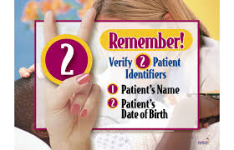


What puts us at risk for a BREACH
Enemy #1 – PAPER
Discharge paperwork, After Visit Summary or prescriptions given to wrong patient.
Unsecure records
Protected health information dropped in hallway, cafeteria, parking lot, etc.
Improper Disposal
Placing protected health information in trash instead of shred box.
Notes:
Keep documents containing PHI secure when not in use
Place written materials in secure areas that are not in view or easily accessed by unauthorized persons
Do not leave materials containing PHI on desks or counters, in conference rooms, in restrooms, on printers, etc.

Slide 10

What puts us at risk for a BREACH
Searching
Using Epic to find information like a phone number, address, date of birth, or room number for an individual such as a co-worker, family member, neighbor, friend, etc. for personal reasons.
Also, not locking computer workstation, you will be held responsible for access
under YOUR credentials!
REMEMBER Epic is not Google!!!

Slide 11

Accessing EPIC
Do’s:
  Only access medical records for which you have a job reason to do so
Don’ts:
  Accessing your own medical record or the medical records of family members through the Electronic Health Record (EPIC)
      To access your own medical record, you must use MyChart
      To access a family member’s chart, that family member must give you permission and provide you with the log-in credentials to access the family member’s MyChart
Inappropriate access into the medical record is a HIPAA Violation and can result in corrective action

Slide 12
Access ONLY what you need to do your job!
It’s as simple as that.
If you can do your JOB without it, don’t access it.

Slide 13
Protenus
ECU Health uses a tool called Protenus to identify potentially inappropriate accesses to the electronic health record
  Protenus looks at EACH and EVERY access to the electronic health record
  Identifies potential inappropriate accesses
    Co-workers
    Family Members
    People in the news media
Notes:
So you ask, how does Protenus know – it compares addresses, emergency contact, employee addresses, etc. to identify what might be a potential inappropriate access. It will not flag the record, if you are part of the care team.

Slide 14


What puts us at risk for a BREACH
Release of Information
Discussing protected health information to visitors without patient consent.
Loose Talk
Telling others about patient diagnosis, treatment plan, etc.
Avoid conversations involving PHI in public or common areas such as hallways, elevators, cafeterias, etc.

Slide 15


What puts us at risk for a BREACH
Misdirected Faxes
VERIFY the recipients fax number and CONFIRM you dialed the correct number
SELECT the correct ordering provider to receive results
Lost and Stolen Devices
Portable devices with PHI left in unsecure areas such as the cafeteria, bathroom or your unlocked car
IT has implemented security measures to reduce the loss of PHI on personal phones, if your device is lost, contact IT for assistance with removing the PHI

Slide 16
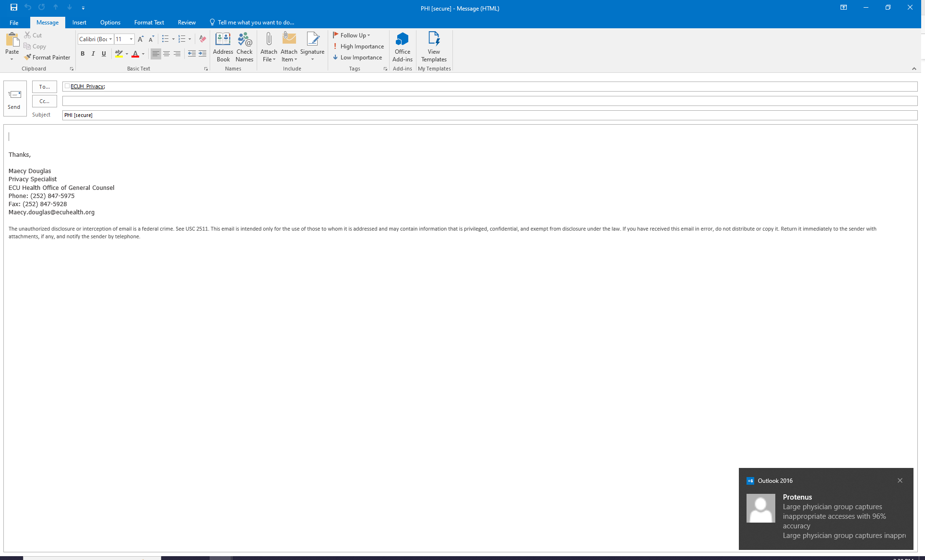
What puts us at risk for a BREACH
Unencrypted Data
Emails containing PHI should be encrypted using [secure] in the subject line of the email

Slide 17

What puts us at risk for a BREACH
  Contacting Patients
  Make every effort to speak to the patient directly
  Never leave voice messages containing information regarding condition, test results, specifics about treatment, etc.
  If you must leave a message, leave your name, ECU Health, and your phone number only – not specific department, office location
  Do not state the reason for the call
Notes:
In general, the amount and types of PHI used or disclosed is restricted to the minimum amount of PHI necessary to satisfy the request.
“Reasonable efforts” must be taken not to disclose more than the minimum amount of PHI necessary to accomplish the intended purpose.
Does not apply in disclosures for treatment purposes to other providers or for release of PHI to patient pursuant to their own authorization.
Reasonable questions include certain personal information regarding patient, such as DOB, maiden name, etc.
(not information such as telephone number, address, etc.)

Slide 18

What puts us at risk for a BREACH
Social Media
Post/comment/message/picture about a specific patient
Any image of a patient shared where they could be identified
Responding to comments and including any identifiers of PHI
Sharing PHI in ANY social forum without patient’s consent - in private groups as well
Recognition that someone is a patient (“It was nice to see you the other day,” or “Glad you enjoyed your visit.”)

Slide 19
Social Media …. Bottom line
No form of PHI is to be shared on social media without authorization
If you don’t know if posting something might be a HIPAA violation,
DON’T post it!

Slide 20
HIPAA and Photos
What pictures qualify as PHI?
  Any photo that shows individually identifiable information of a patient is considered PHI
    Patient’s face, name or initials, their date of birth, the date of their treatment or
    Photos of birthmarks, moles or tattoos, and other identifying features
  High profile patients with specific injury (shark bite wounds)

Slide 21
HIPAA and Photos
  Storage
    Photos containing PHI should not be stored on any device for an indefinite amount of time and all devices should be wiped of PHI photos before it ever leaves the office
  Communications
    With photos containing PHI, team members and providers must be careful to never email, text or otherwise send without proper encryption software
      Cortext and Haiku

Slide 22
Violations, Sanctions, Penalties
Individuals under the purview of ECU Health who do not follow HIPAA rules are subject to corrective action
The level of corrective action is dependent upon the severity of the violation, the intent, patterns or practices of improper activity, etc. and can range from a documented counseling/performance conversation up to and including separation
There are also potential civil and/or criminal penalties that may apply
Notes:
Civil
The penalty for healthcare organizations is based on the extent to which the entity was aware that HIPAA Rules were violated.
Criminal
Criminal penalties apply if employees or other individuals obtain or disclose PHI from covered entity without authorization
Penalties can range from fines to prison time depending upon the nature of the allegation

Slide 23
Examples of HIPAA violations
    Failing to log off a computer resulting in an inappropriate access
    Leaving PHI in a non-secure location
    Inappropriate hallway conversation
    Unauthorized access to PHI including access to PHI without a job related reason
    Providing passwords to unauthorized users
    Sharing PHI with unauthorized individuals
    Inappropriately disclosing PHI outside of ECU Health
    Accessing and using patient data for personal gain or malicious intent
    Destroying PHI intentionally

Slide 24
Your Responsiblity
  The Golden Rule - Treat others PHI the way that you would want your PHI treated!
  Be respectful and thoughtful
  An ounce of caution on your end, prevents hours of time on our end.

