Slide 1
ECU Health Compliance Education
Office of Audit and Compliance

Slide 2
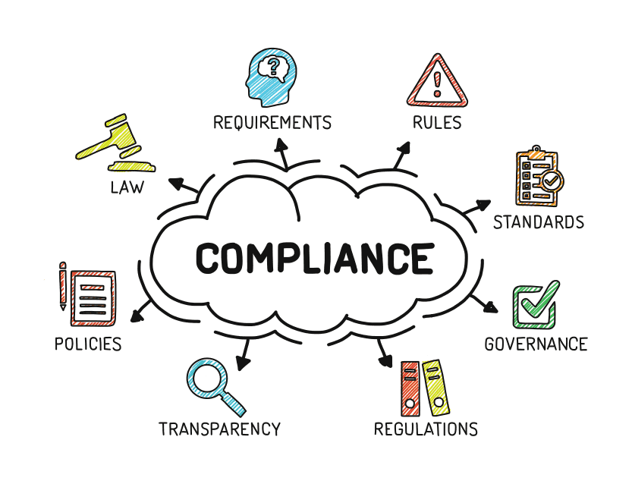
What is Healthcare Compliance
Healthcare compliance is the practice of adhering to federal, state and local laws and regulations. Compliance laws are intended to help protect patients, safeguard sensitive information and help mitigate and prevent fraud, abuse and waste in the healthcare industry.

Slide 3
How do we ensure Compliance?
Prevent, detect, and avoid fraud, waste and abuse
Follow organizational policies, state & federal laws and regulations
Effective training, communication, monitoring, enforcement and response

Slide 4
Fraud, Waste & Abuse

Slide 5
Examples: Fraud, Waste & Abuse
Fraud:
Billing for services not rendered
Billing multiple time for the same service to receive duplicate or multiple payments
Waste:
Misuse of funds or resources through excessive or nonessential expenditures
Abuse:
Providing services that are not medically necessary
Negligent practices that result in duplicate payments

Slide 6
Fraud, Waste & Abuse Laws
Laws are very broad and complex
Laws apply to a variety of common financial relationships that are not obvious kickbacks or fraud
Penalties are serious
Enforcement is rising because of financial benefit to government
Mistakes are not fraud, however… the lack of an organizations efforts to control mistakes may be deemed as fraud

Slide 7
Federal False Claims Act 31 U.S.C. §§ 3729-33
Prohibits anyone from “knowingly” submitting a false or fraudulent claim for payment to the government.
“Knowingly” means:
Actual knowledge that the information if false
Acts in deliberate ignorance or reckless disregard of the truth or falsity of the information
No proof of specific intent to defraud is required
Criminal Penalties
Felony conviction: 5-20 years in jail
Misdemeanor conviction: 1 year in jail
Civil Penalties:
Triple damages and penalties of $11,665 to $23,331 per false claim for submission or causing submission of false claim.
False Claims “can” result from actions such as:
Billing for services not rendered
Up-coding
Double-billing
Lack of medical necessity
Pattern of insufficient documentation
Violation of billing rules
False certification

Slide 8
False Claims and Qui Tam
Federal
False Claims Act
Qui Tam
Actions
Allows a private person (a “qui tam relator”) to bring a civil action in the name of the United States
Qui tam relators share in any money recovered (including settlements)
If government joins in action, relator is entitled to 15% to 25% of proceeds depending on relator’s contribution to the case.
If government does not join in action, court may award relator not less than 25% and not more than 30% of proceeds.

Slide 9
Federal Anti-Kickback Statute (42 USC § 1320A-7B(B))

Slide 10
Federal Anti-kickback Statute
The Federal Anti-kickback Statute makes it a felony to knowingly and willfully solicit, offer, receive, or pay anything of value in return for referrals for a service, item, or procedure that is paid for by a federal healthcare program.
What could happen?
Civil monetary penalties up to 3x the amount of kickback and $50,000 per violation
Exclusion from federal health care programs
Criminal and civil liability up to $25,000 fine and/or 5 years prison term for failure to comply
Possible False Claims Act violation
Kick-back Examples:
Money, discounts, gifts, credits

Slide 11
Federal Physician Self-Referral Stark Law (42 USC § 1395NN)

Slide 12
Federal Physician Self-Referral Prohibition (Stark Law)
What Is it?
The Federal Physician Self-Referral Prohibition or Stark Law prohibits a physician from referring Medicare patients for designated health services to an entity that the physician (or immediate family member) has a financial relationship, unless an exception applies.
Prohibits the designated health service entity from submitting claims to Medicare for those services resulting from a prohibited referral
What could happen?
Repayment obligation
Federal False Claims Act liability
Civil monetary penalties up to $15,000 per inappropriate referral and civil assessment up to 3x the amount claimed
Federal health care program exclusion
Stark Safe Harbor:
Safe Harbor requires no assumption of the downside risk by parties to a value-based agreement. The Stark Value-Based Arrangements exception protects physician compensation arrangements that qualify as value-based arrangements, regardless of the level of risk undertaken though the arrangement.

Slide 13
Documentation

Slide 14
Documentation and Billing Compliance
Accurate documentation and billing is critical
Incomplete documentation could cause potential concerns for fraud and abuse
If audited…. If it wasn’t documented, It didn’t happen!
Fraud, Waste and Abuse could result in stiff penalties, fines and even jail time

Slide 15
Documentation in the Electronic Medical Record
It is prohibited to share your password
Use of copy/past and “make me the author” functions are not recommended
Easy for internal reviewers and external auditors to track changes
Only document what was done
You are responsible for your own documentation

Slide 16
Reporting Incidents of Non-Compliance
Encouraged to use immediate supervisor, manager, director or administrator for first line of reporting of any known or suspected incidents of non-compliance.
There will be no retaliation taken against any individual reporting an incident
Confidentiality will be maintained to the fullest extent possible.
Ability to remain anonymous

Slide 17
Compliance Hotline
Kristen Gonzalez, Chief Compliance Officer
Carla McKeithan, Dir. of Compliance
ECU Health Compliance Hotline: 1.888.777.2617
Email: Compliance@ECUHealth.org
Available 24 hours a day, 7 days a week
ECU Health, Office of Audit and Compliance Phone: 252.847.0125

