Slide 1
NEW EMPLOYEE ORIENTATION
Paige Tyson
Office of Training & Engagement, Manager

Slide 2
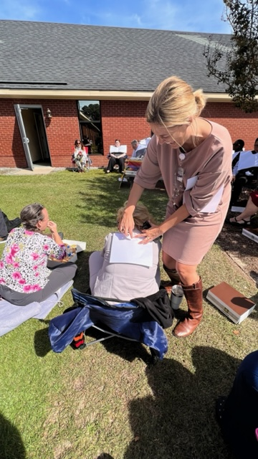
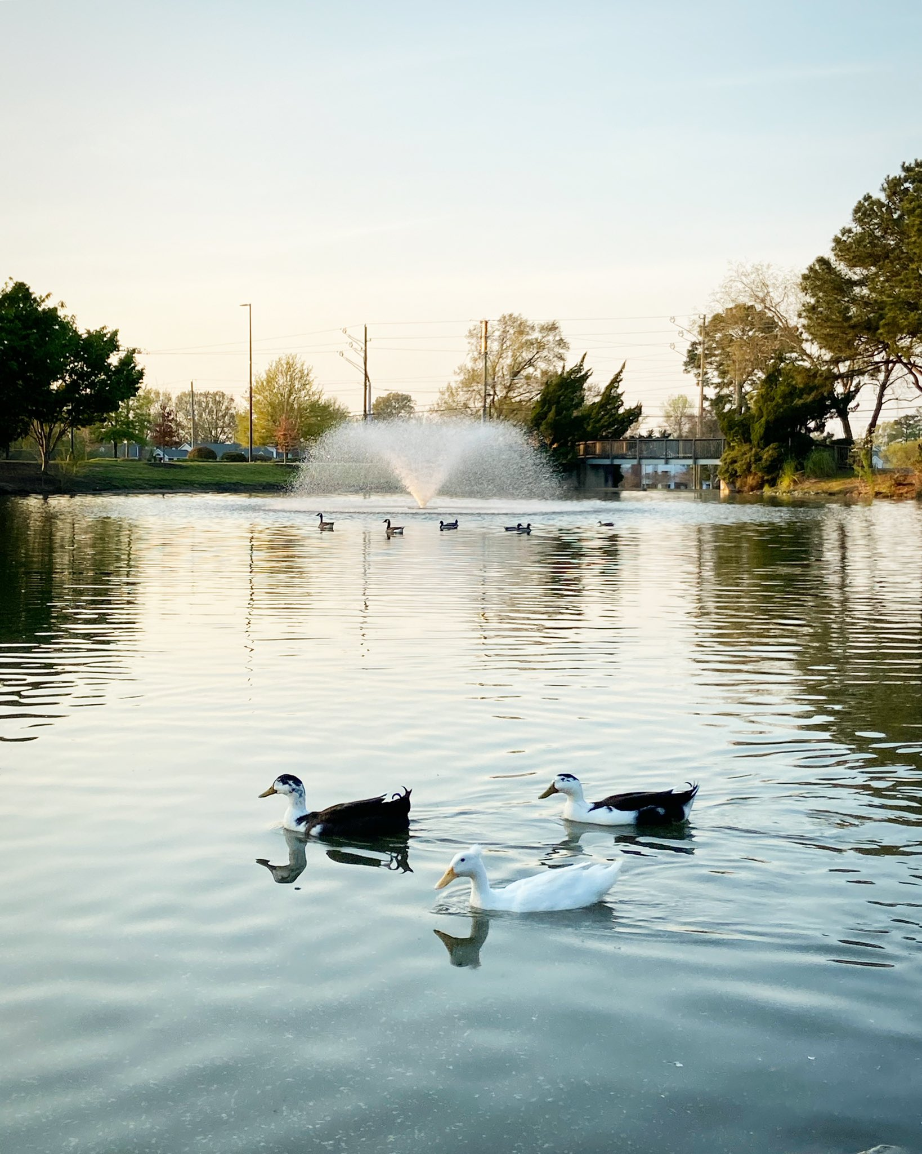
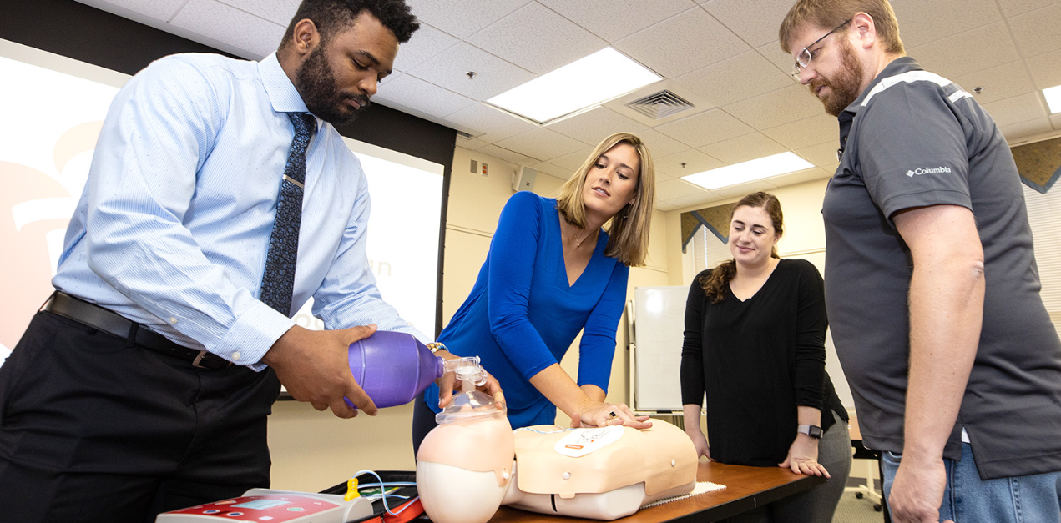
How can I be of service to you now and throughout your employment?
Team building, picnics, Basic Life Support, campus tours, etc.

Slide 3
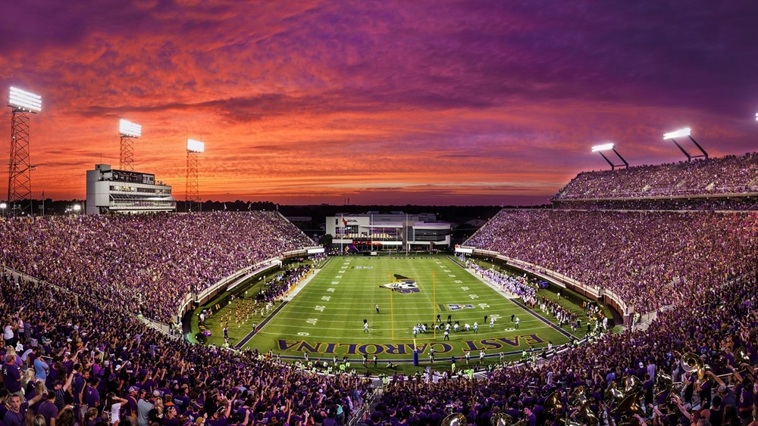
Is anyone new to Greenville?
Is anyone new to Eastern NC?
Best of Greenville - 2021 by APG Eastern NC - Issuu
https://ecupirates.com/

Slide 4
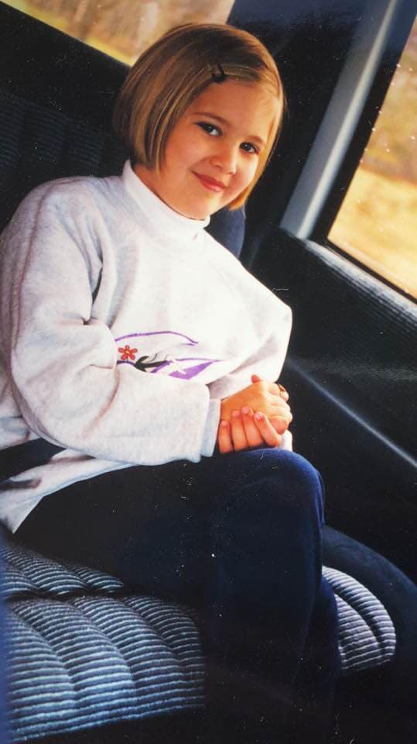
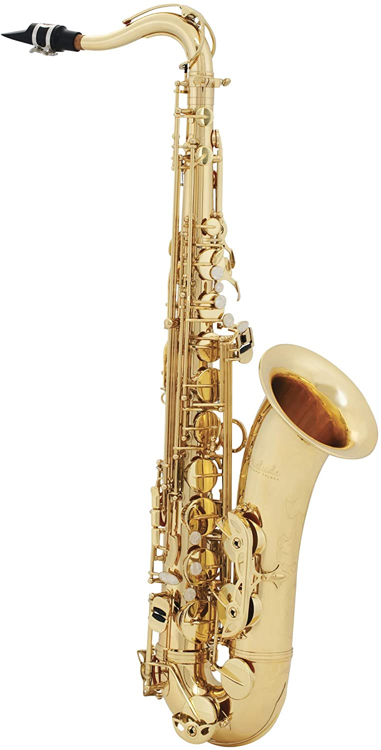
What are some of your favorite things? I’ll go….

Slide 5
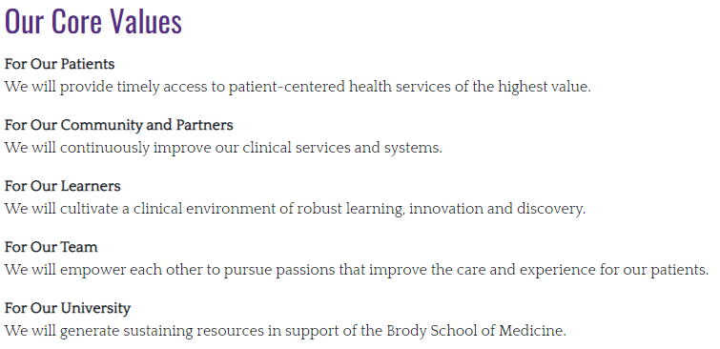

Slide 6
Time | Topic | Presenter
8:00 – 9:00 | Sign-in Personality Assessment What I Wish I Knew as a New Employee Helpful Handouts Where to be after today | Office of Training & Engagement
9:00 – 10:00 | HIPAA Compliance, Privacy, & Security | ECU Office of Institutional Integrity
10:00 – 10:15 | Risk Management | ECU Brody School of Medicine Office of Risk Management
10:15 – 10:30 | BREAK | -
10:30 – 11:00 | Bloodborne Pathogens, Infection Control, & Tuberculosis Training | ECU Office of Prospective Health
11:00 – 11:30 | PPD (TB Skin Test) and/or Respirator Fit Testing | ECU Office of Prospective Health
11:30 – 1:30 | LUNCH on your own | -
Everyone will return to your worksite at 1:30 …. UNLESS….

Slide 7
….you are a NA, CMA, or RN……
Packet given to you
Time | Topic | Presenter
1:30 – 3:30 | Point of Care Lab Testing | David Van Cura COME BACK HERE
No one will return to this training room after today!

Slide 8
Are you expected to be at any trainings after today?
Who? | Topic | Location
Credentialed Providers | Wednesday 8a – 4p ECU Ambulatory EPIC Training (ECU Health Inpatient Orientation Thursday 252-847-DOCS) | VIRTUAL WEBEX
Clinical Staff Documenting in Patient Chart | Wednesday report to worksite; Thursday 8a – 4p ECU Ambulatory EPIC Training | VIRTUAL WEBEX
Patient Access Services (Administration) | trainrev@ecu.edu Thurs – next Wednesday EPIC training | Brody School of Medicine 2N-78
Packet given to you
E-mail will be sent to you

Slide 9
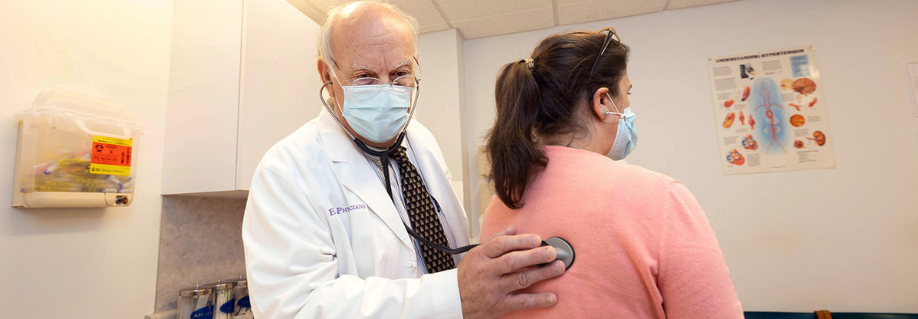
EVERYONE
Applicable to some
EVERYONE
HIPAA +
Bloodborne Pathogens
Required EPIC trainings
Ready to start seeing patients!

Slide 10
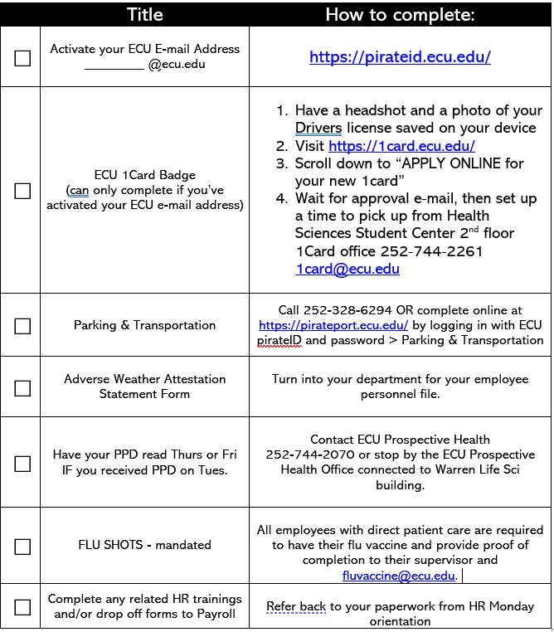
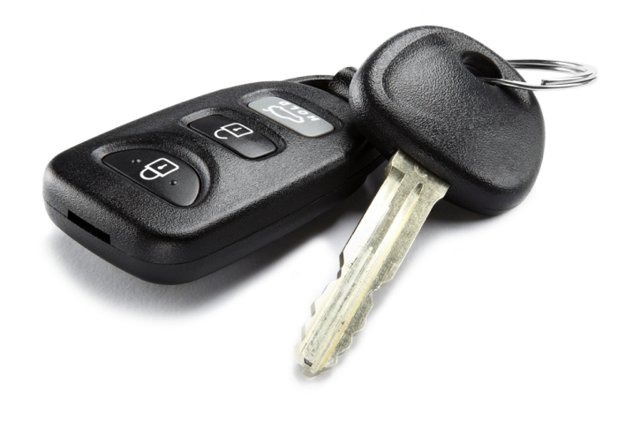
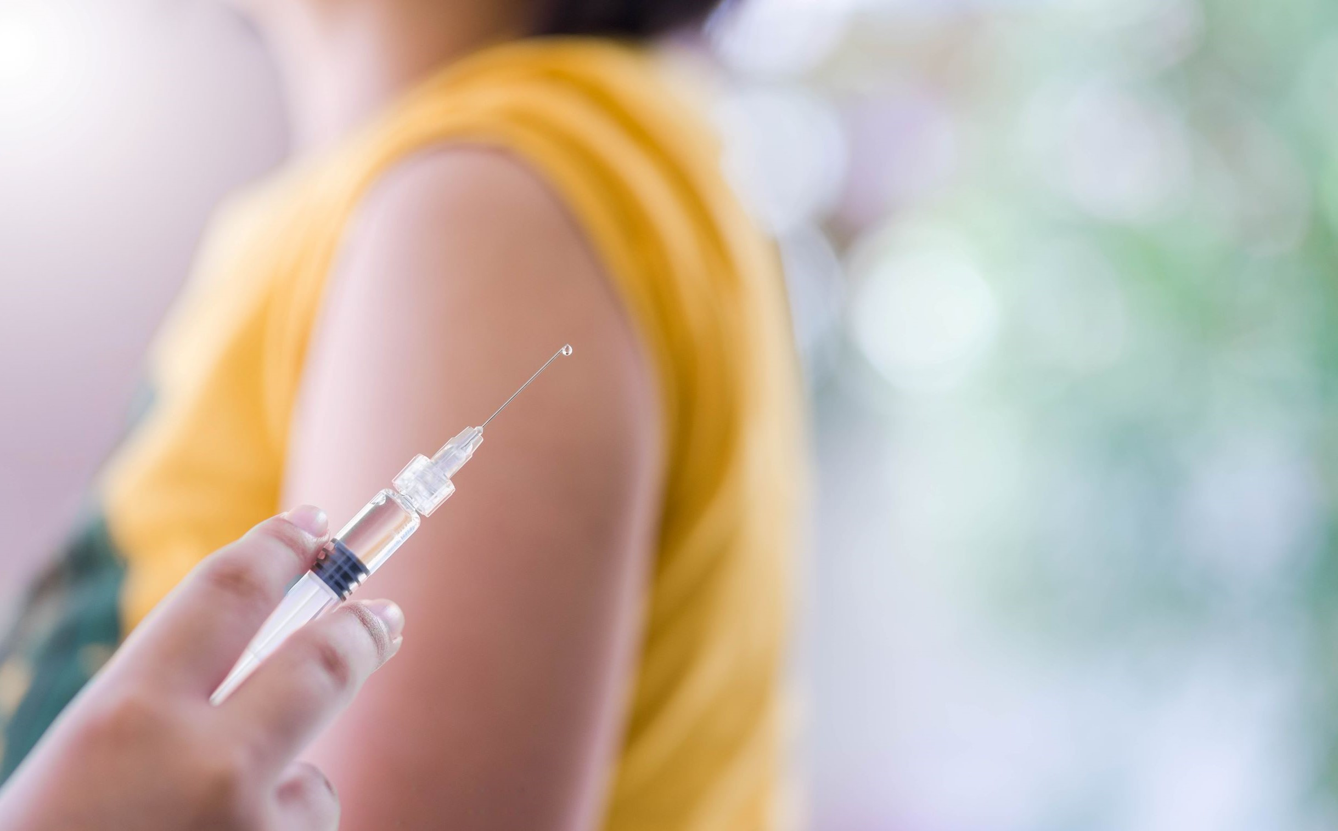

Slide 11
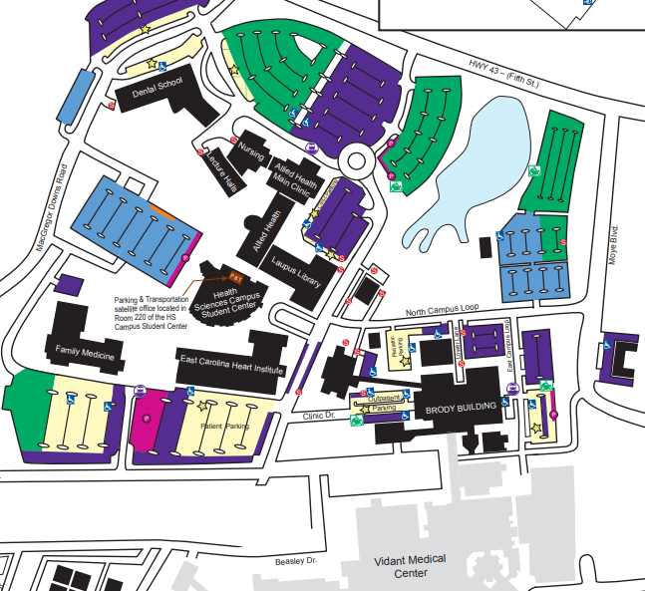
Heading back to HR
Memorial Drive
Heart Drive
EPIC
1800 W. 5th Street – EPIC and Point of Care Testing
Arlington Blvd
ECU 1card badges
Food Lion and food
EPIC
PPDs
ECU Health Medical Center

Slide 12
What questions do you have for me?

